Slide 1

DATA SCIENCE
(BIG DATA)
M.ABDUL RAOUF - 21071A7242 AI&DS

Slide 2
INTRODUCTION
Today, we’re surrounded by data. People upload videos, take pictures on their cell phones, text friends, update their Facebook status, leave comments around the web, click on ads, and so forth. Machines, too, are generating and keeping more and more data.
As the cost of computing power, data storage, and high bandwidth Internet access and have plunged exponentially over the past two decades data is the source for corporate
energy and differentiation in the 21st century.

Slide 3
ABSTRACT
Data Science refers to an emerging area of work concerned with the collection, preparation, analysis, visualization,
management, and preservation of large collections of information. Although the name Data Science to connect most strongly with areas such as databases and computer science, many different kinds of skills - including non
-mathematical skills are needed. Data science most often refers to the tools and methods used to analyze large amounts of data in many fields.

Slide 4

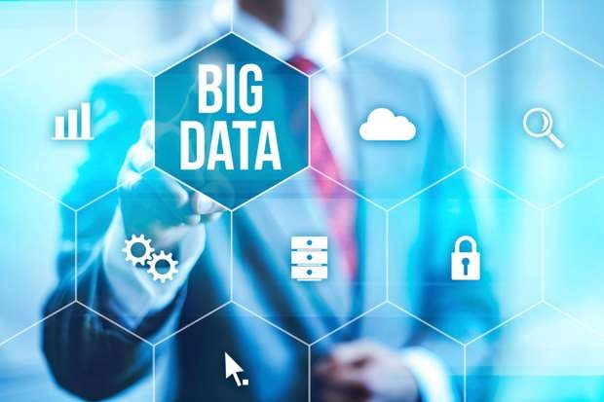
BIG DATA
What is Big Data…..???
Data science break big data into four dimensions
Volume
Variety
Velocity
Veracity.

Slide 5
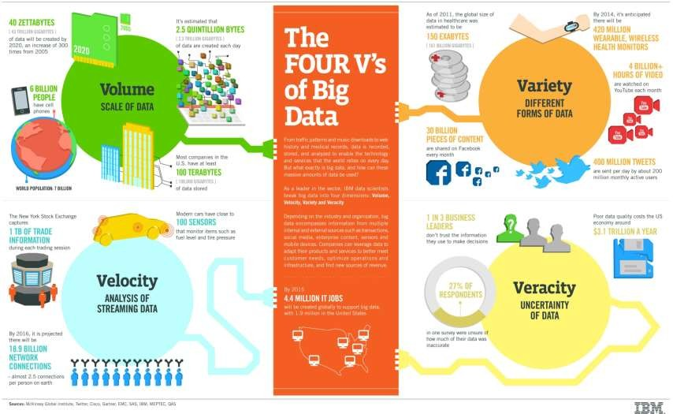
BIG DATA

Slide 6
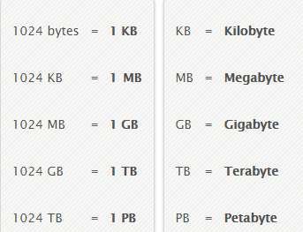
Why Big Data….???
Facebook is collecting your data -
500 terabytes a day.
Google currently processes over -
20 petabytes of data per day .
Day, week, month, year….???

Slide 7
So What do we Do….
Parallelization
The obvious solution is that we use multiple processors t o solve the same problem by fragmenting it into pieces.
Imagine if we had 100 drives, each holding one hundred th of the data. Working in parallel, we could read the data in under two minutes.

Slide 8
Where is Big Data Used…..???
The Awesome Ways Big Data Is Used Today To Change Our World
Understanding and Targeting Customers
Improving Science and Research
Improving Security and Law Enforcement.
Improving and Optimizing Cities and Countries
Financial Trading
Improving Sports Performance
Improving Healthcare and Public Health
Personal Quantification and Performance Optimization
Understanding and Optimizing Business Processes

Slide 9
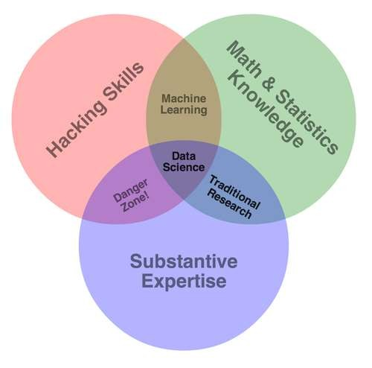
DATA SCIENCE LOOP

Slide 10
Programming languages…
Big Data - Not a Big Deal for Conventional Programmers
Hadoop
Python
R language
SAS (Statistical Analysis System)
JULIA

Slide 11
Big Words About Big Data…
A McKinsey Global Institute report estimates that by 2018, “the United States alone could face a shortage of 140,000 to
190,000 people with deep analytical skills as well as 1.5 million managers and analysts with the know-how to use the analysis of big data to make effective decisions.”
“Data Science is the Most Trending job for the 21st century ”
“Data is the new science. Big data holds the answers.” – Pat Gel singer, CEO, EMC, Big Bets on Big Data, Forbes

Slide 12
Future Scope
Data Science is necessary for companies to stay with the pack and compete in the future.
Organizations are constantly making decisions based on gut instinct, loudest voice and best argument – sometimes they are even informed by real information. The winners and the losers in the emerging data economy are going to be determined by their Data Science teams.

Slide 13
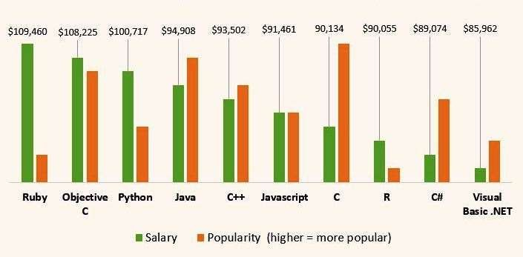
Big data means big compensation for data scientists.
Data scientists are some of the most expensive and coveted professionals around today. "It’s important to note that data mining as it relates to data science is not traditionally taught in university-level computer science curricula," says Ray Bao data scientist at CyberCoders.

Slide 14
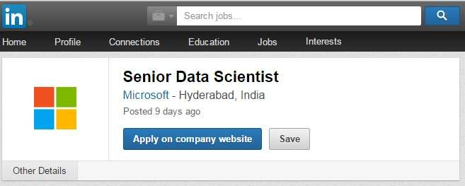
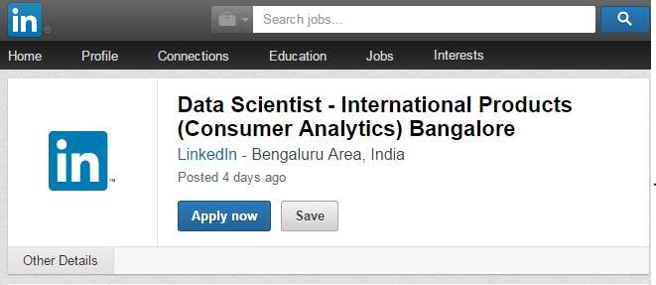
Career

Slide 15
Tell Your Kids to be Data Scientists – Not Doctors
In the days of yore parents pushed their children to pursue noble lucrative professions – doctor, lawyer, banker – but as times change they may
soon encourage another career path: data scientist
.

Slide 16
Thank you for
your attention

